Slide 1
Linux File System
and
INode
——Kunling Zeng
kzeng3@gmu.edu
Notes:
greeting & My project topic is “……"
->I will first introduce Linux file system roughly, then turn our focus to INode, combining the source code to explore the implementation of INode.

Slide 2
Linux File System and INode
File System:
The structure and logic rules used to manage groups of information and their names .[1]
ext2($mke2fs)
↑$mount
create a root directory(as the mount point)
storage device
↔︎
block device
↑
create a file($dd)
+ loop device($lesetup)
Mounting
Notes:
->the definition of file system ….
->and these Info is stored in some kind of storage device.
we could create a block device by associate a file with a loop device, then, we create a ext2(second extended filesystem)
->now, we have the file system and the storage device, we want to use this file system to manage the data on this device.
-> so we use &mount command.
$mount attache a file system to a root directory on a storage device, this process is called mounting

Slide 3
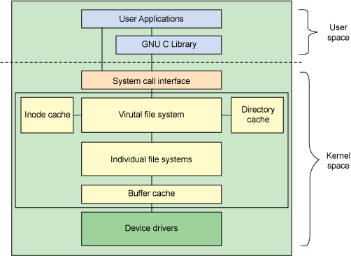
Linux File System and INode
Linux File system interface is implemented as a layered architecture
Linux File System:
Superblock, Inode, dentry, file
Superblock:
a structure that represents a file system.
dentry: inode numbers ↔︎file names.
VFS: act as the root level of the file-system
interface
Architectural view of the Linux file system components[2]
Notes:
-> Linux File system interface is implemented as ...
->let’s take a look at the …
the majority of the file system code exist in the kernel space, and it is also our focus.
->Linux views all file systems from the perspective of a common set of objects. These objects are
among these:
->superblock：it is … we will talk more about it later.
->A dentry is the glue that holds inodes and files together by relating inode numbers to file names.In other word, dentry is used to translate between file names and inodes. the directory cache keeps the most-recently used dentries .
-> In this architecture, VFS act as ... it maintains two lists.

Slide 4
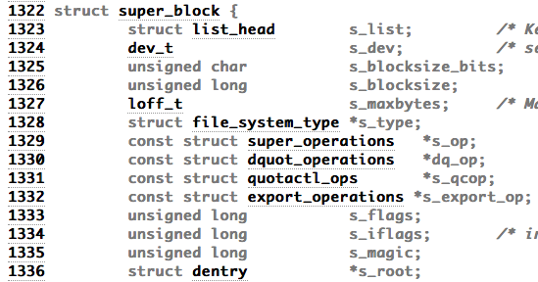
Linux File System and INode
VFS → file_systems →
file_system_type
…
file_system_type
list (currently mounted file systems)
↓
Notes:
-> one of the list is the file_systems list,
this is a list of structure file_system_type,this structure defines the file systems that can be supported in the system. it includes the name of this each file system, a set of attributes and two super block.
-> Recall the process when we create file system. A system is supported doesn’t mean that it exists in the system. we need to mount them on a device, And that is the other list maintained by VFS: the list of currently mounted system.
-> and the element of this list is the vfsmout structure.let’s take a look at this structure.
-> It is a very succinct structure, with the mount point, some flags, and we notice the element superblock
->As we mentioned before, superblock is “a structure presents a file system”.
it is essentially file system metadata and defines the file system type, size, status, and information about other metadata structures (metadata of metadata).
-> list_head —— the mounted file systems are double linked
file_system_type, as we have saw before
the element “structure dentry *s_root” tells us the inode of the root directory
We turn our focus to the element “super_operations”, it leads us to INode.

Slide 5
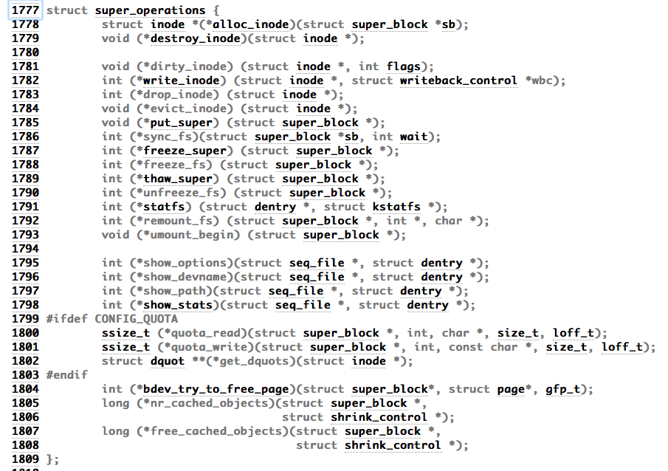
Linux File System and INode
Notes:
-> super_function defines the function to manage INode within this file system. and these functions are file system dependent.
-> From this code we could see it includes alloc_indode, write_inode and destroy_inode and so on.
-> we first take a look at the implementation of INode then we turn to alloc_inode source code.

Slide 6
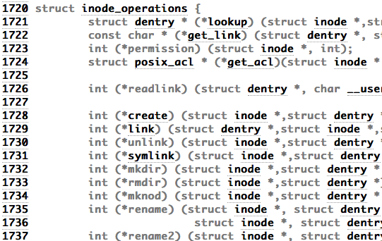
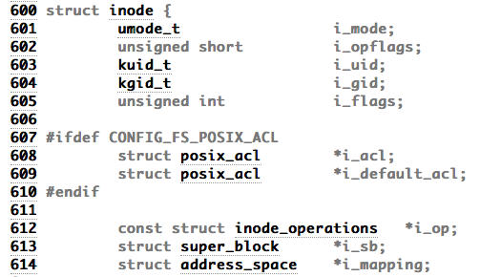
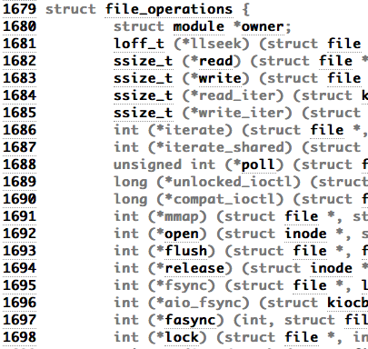
Linux File System and INode
…..
Notes:
-> we see some elements corresponding to the POSIX, uid, gid, flags, timestamps and so on. we pay attention to inode_operations and file_operations these two elements,
inode_operations define those operations that operate directly on the inode and file_operations refer to those methods related to files and directories (the standard system calls).
->in file_operations we see read, write, open and so on
and in the inode_operations we could see create, link, unlink, mkdir, rmdir these prototype of our familiar system calls, and notice each of these functions all has the parameters inode and dentry, as we know that these operations all affect the inode, and we need to modify dentry correspondingly since it maintain the translation between inode and filename.

Slide 7
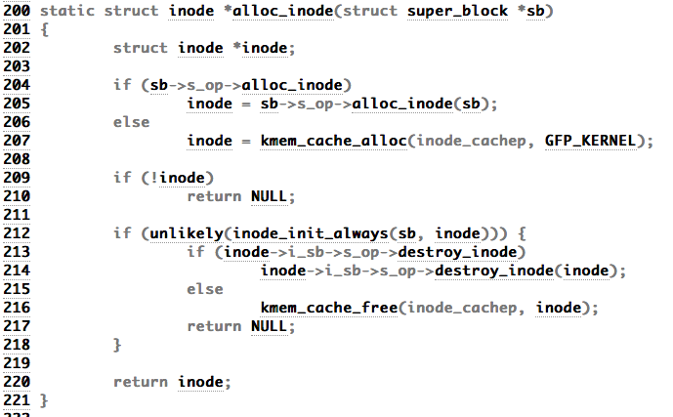
Linux File System and INode
Notes:
-> Now we take a look at the alloc_inode function, first claim a inode variant, then check if the superblock(the file system) defines specific allocation function, if not, use the default one.

Slide 8
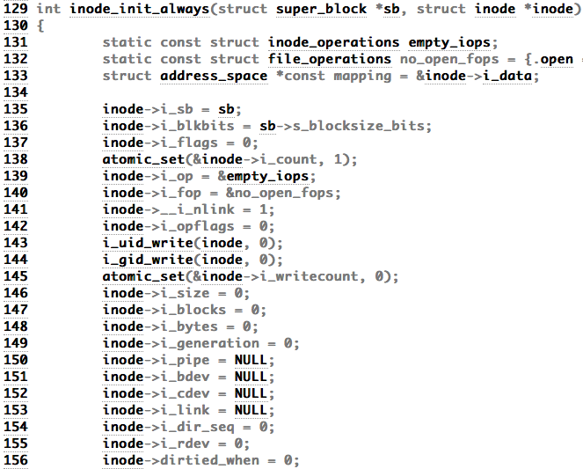
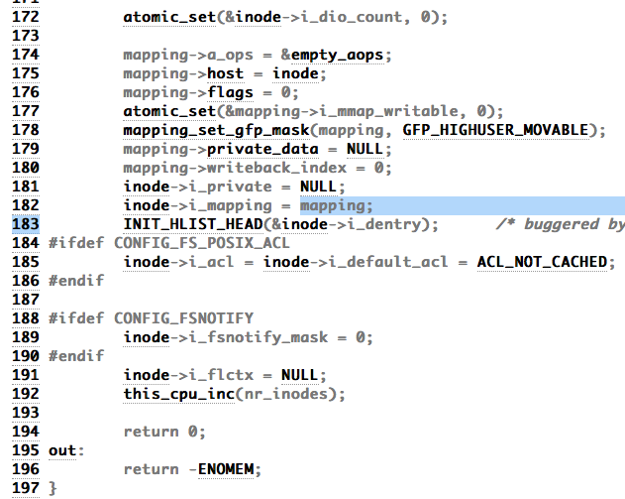
Linux File System and INode
Notes:
-> Then we look inside the initialization of node.
Nothing special but we can see the mapping process, and we notice the atomic function of setting i_count.

Slide 9
Linux File System and INode
Reference:
[1] https://en.wikipedia.org/wiki/File_system
[2] https://www.ibm.com/developerworks/library/l-linux-filesystem/

Slide 10
Linux File System and INode
Thank you~
——Kunling Zeng

